Slide 1
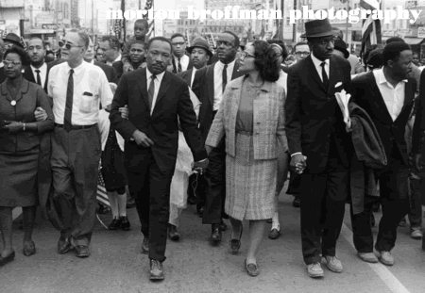

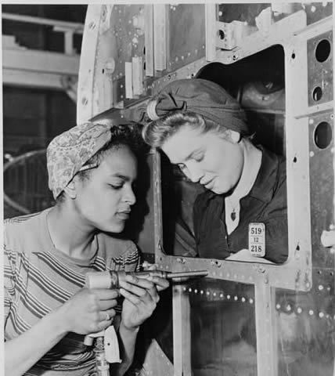
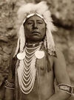
Civil Rights in the USA 1865–1992
What do we study in this topic?
Q1: What are Civil Rights?

Slide 2
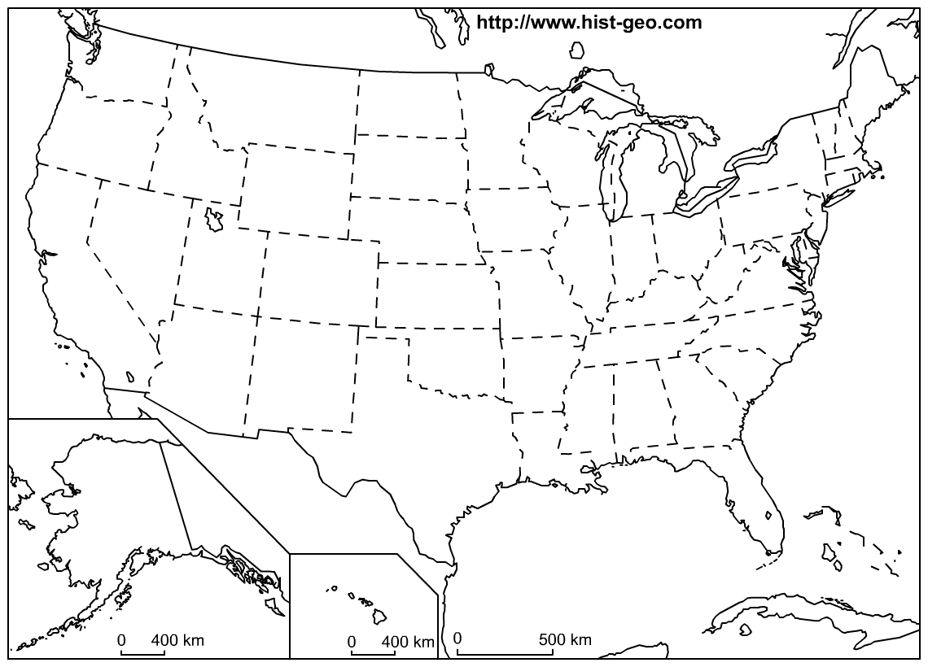
Q2. Write down the names of the 50 US states on the map

Slide 3
Q3. Watch this 5 min clip and make notes around this heading
http://www.youtube.com/watch?v=44wJ1gnBK0c
What was the importance of the American Civil War?

Slide 4
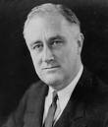

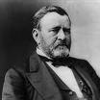
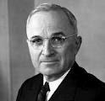

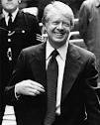

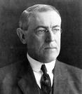

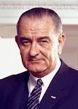
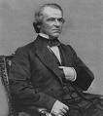

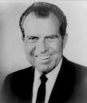
Q4. Find out the names of these US Presidents from 1860 – 1990 and number them in chronological order with dates for their terms in office.
Q5. Choose 3 of these Presidents. Carry out your own research to briefly answer this question in around 100 words for each:
What was his attitude towards the advancement of African American Civil Rights?

